Slide 1
RESEARCH BACKGROUND
Hybrid Composition with IdleBlock: More Efficient Networks for Image
Recognition
University of Science and Technology of China

Slide 2
CONTENTS
01
研究问题
02
相关工作
03
研究内容
04
结论

Slide 3
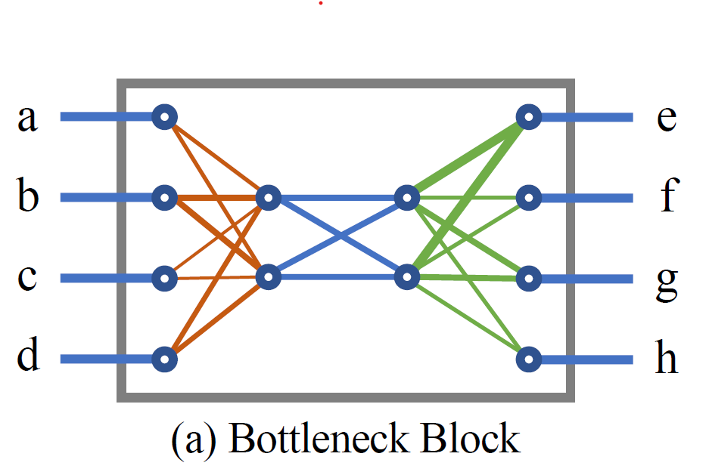
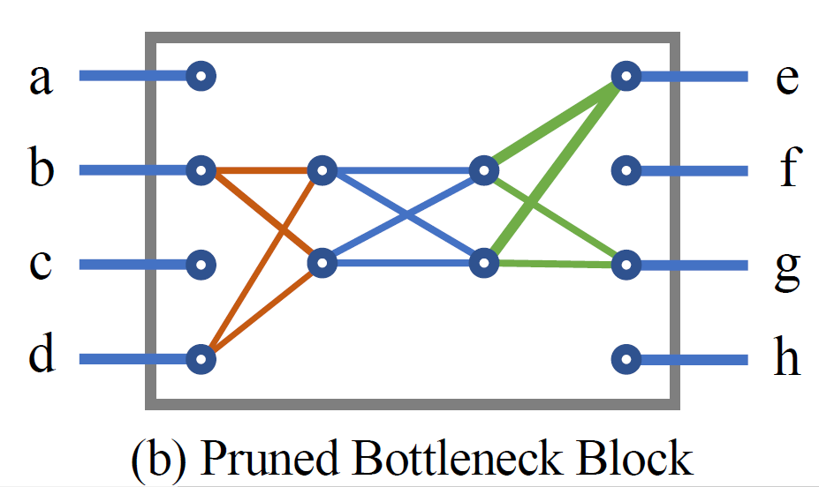
1
研究问题
RESEARCH BACKGROUND
RESEARCH BACKGROUND
Find efficient and state-of-the-art image recognition block !
Accuracy and computation budgets
Notes:
右边计算量少

Slide 4
2
相关工作
human expert-designed architectures
searched architectures
CNN block
Bottleneck block
Inverted Residual block(MBBlock)
Shuffle block
Multiple resolutions information exchanges block
Neural Architecture Search (NAS)
Network Pruning (NP)
Notes:
The motivation of network pruning is: given a pretrained network, an automatic algorithm is able to remove
unimportant connections, to reduce computation and parameters.
NAS attempts to automatically determine the best network connections, block designs and hyper-parameters.

Slide 5
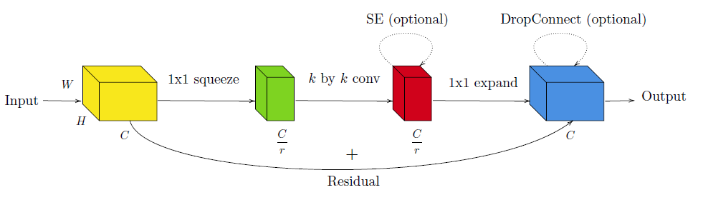
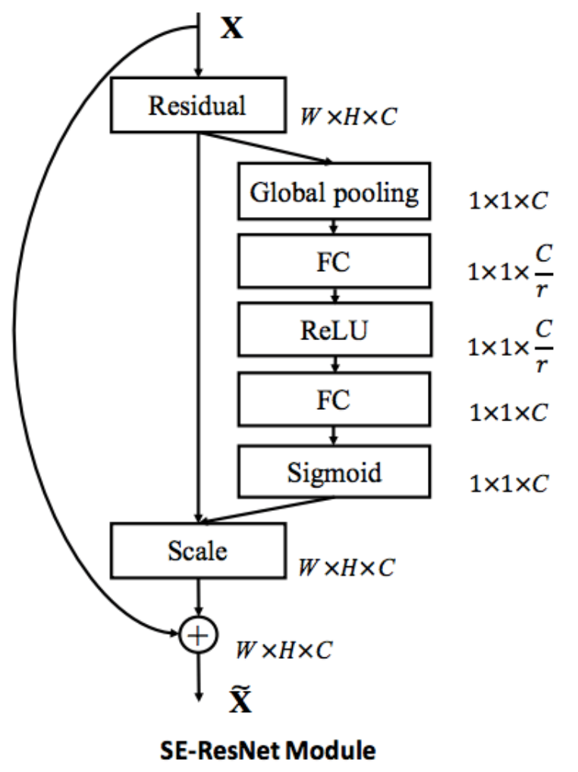
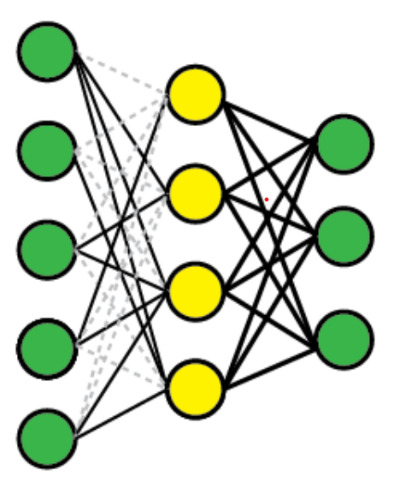
2
相关工作
RESEARCH BACKGROUND
Bottleneck block
Notes:
降维，减少计算量

Slide 6
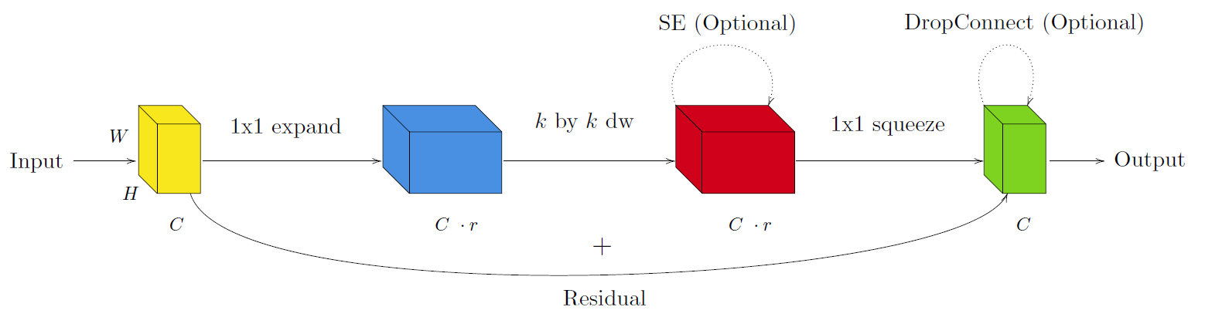
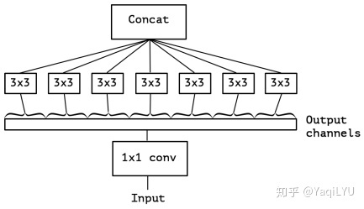
2
相关工作
RESEARCH BACKGROUND
Inverted Residual block(MBBlock)
Depthwise Separable Convolution
Notes:
逐层卷积，减少计算量
实验表明：channel数量增加有利于提高网络表达能力

Slide 7
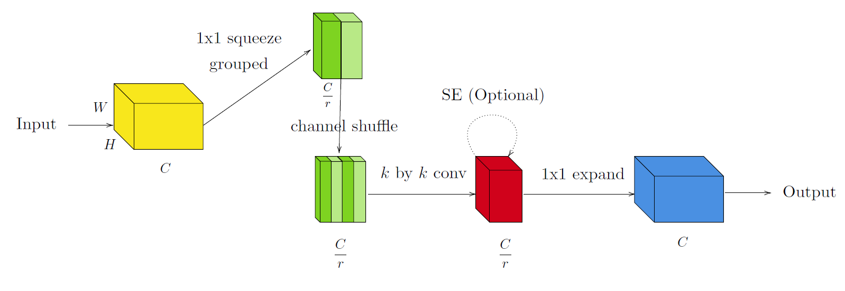
2
相关工作
RESEARCH BACKGROUND
ShuffleBlock v1
Notes:
分成两半
两部分分别做1*1卷积，没有信息交换，最后通过shuffle进行信息交换

Slide 8
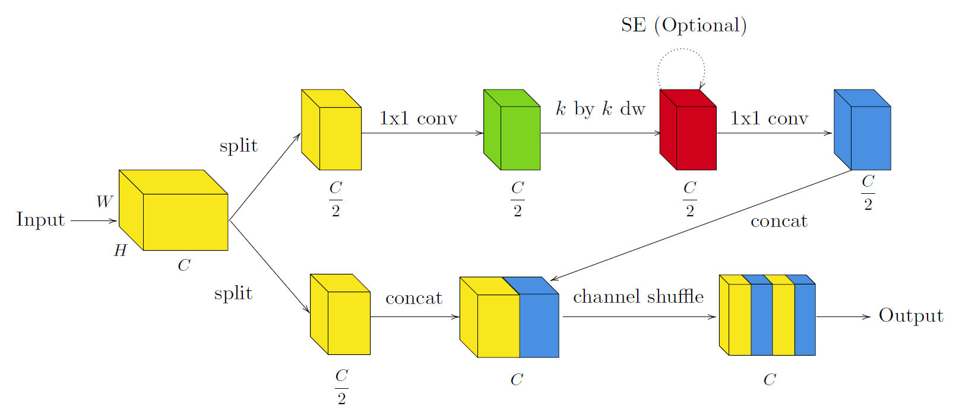
2
相关工作
RESEARCH BACKGROUND
ShuffleBlock v2
Notes:
进一步降低计算量，有一半的channel不做卷积运算
shuffle operation is not efficiently realizable on many hardware

Slide 9
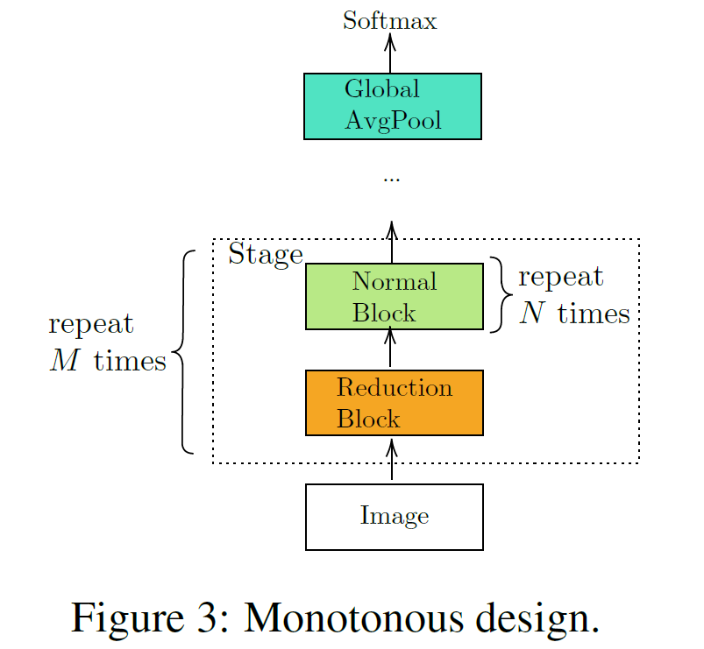
2
相关工作
RESEARCH BACKGROUND
revisit
the modern workflow of obtaining efficient convolutional networks：
First step, we design a network architecture (we insert a reduction block, and monotonous repeatedly stack the normal block).
Second step, we prune connections from the network (it is not be guaranteed that each block has full information exchange).
Notes:
For all the state-of-art networks, to our best knowledge, the blocks are guaranteed to have full information exchange. In the second step,
some connections are pruned, and it is not be guaranteed that each block has full information exchange
重复基本模块（例如前面那4种）
剪枝后，不能保证每个块都有完整的信息交换

Slide 10
3
研究内容
RESEARCH BACKGROUND
RESEARCH CONTENT
3.1
New ideal
3.2
IdleBlock
3.3
Hybrid Composition

Slide 11
3
研究内容
RESEARCH BACKGROUND
New ideal
attempting to reduce computation:
1, Depthwise convolutions is useful.
2, Pruning will reduce computation, but without very specialized implementations. So we seek to introduce structured pruned topology into our block design, which allows us to achieve real-world speed ups. It is Idle.
3, The channel shuffle operation is not friendly to various accelerators, and should be avoided.
Notes:
对前面的网络做一个总结
矩阵运算，如果矩阵找不到巧妙的压缩方式，没办法减少计算
结构性修剪的拓扑结构

Slide 12
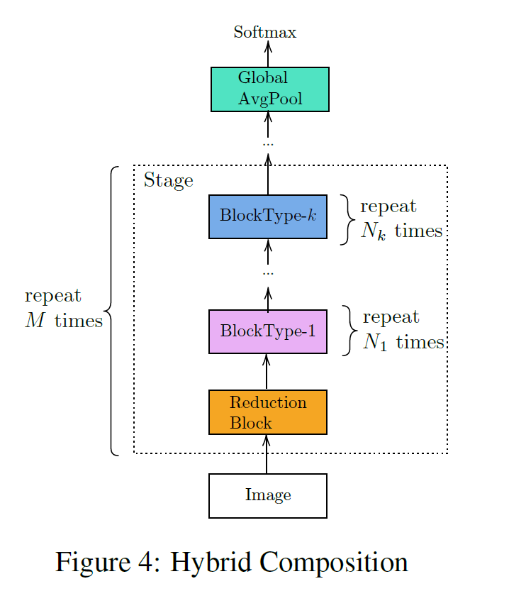
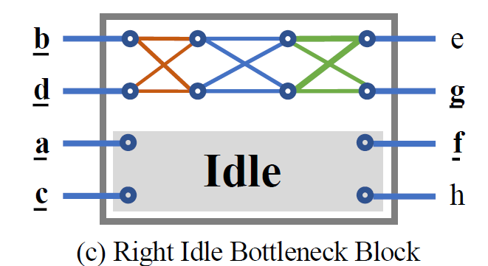
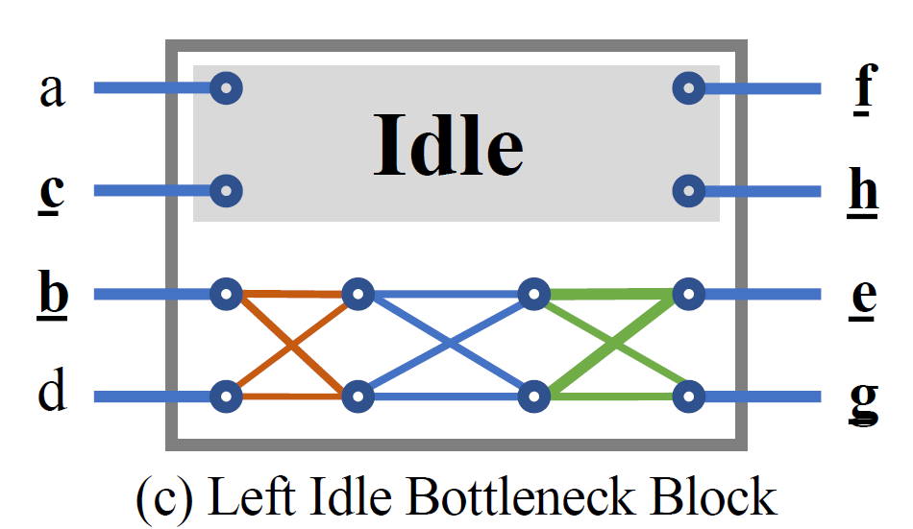

3
研究内容
RESEARCH BACKGROUND
New ideal
New ideal:
Pruned block : Idle (input passed directly to output)
Non-monotonous design : Hybrid Composition
Notes:
两种Idle
本文α=0.5

Slide 13
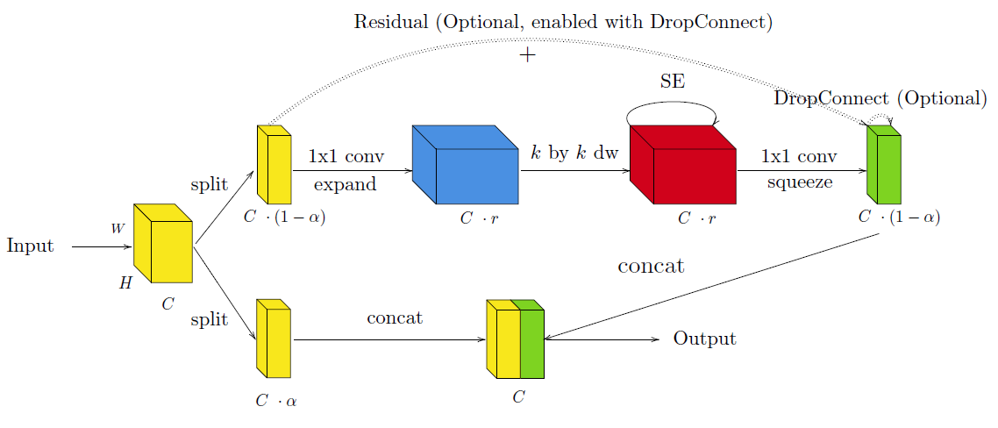
3
研究内容
RESEARCH BACKGROUND
IdleBlock
IdleBlock is an idled version of MBBlock
L-IdleBlock
IdleBlock is an idled version of MBBlock

Slide 14
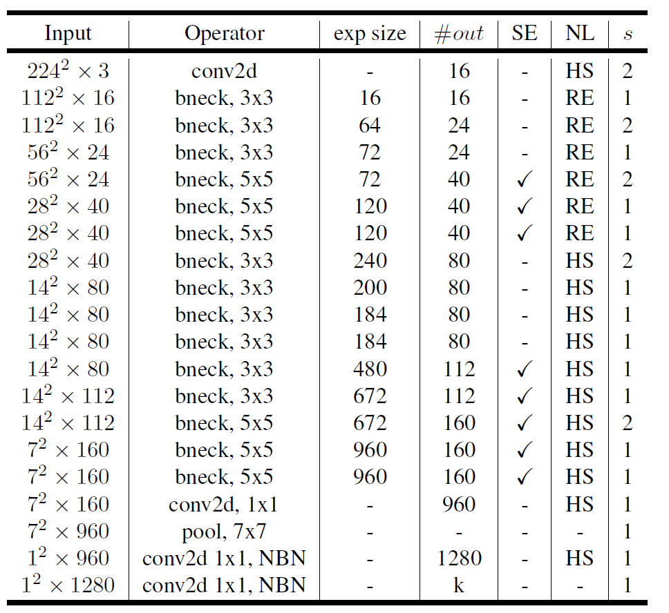
3
研究内容
RESEARCH BACKGROUND
Hybrid Composition
MobileNet v3

Slide 15
3
研究内容
RESEARCH BACKGROUND
Hybrid Composition
hybrid composition of MBBlock with IdleBlock:
Maximum : We only use MBBlock as reduction block, or when the net-work changes the output dimension. All other MBBlocks will be replaced by IdleBlock.
None : none of any blocks in the stage will be replaced with IdleBlock.
Adjacent : We iteratively replace each MBBlock that has an MBBlock input with an IdleBlock, stopping when we reach our specified computational budget.
Notes:
MBBlock模块有1*1卷积减少channel过程，这个过程可以交换不同channel的信息，就不需要shuffle过程了

Slide 16
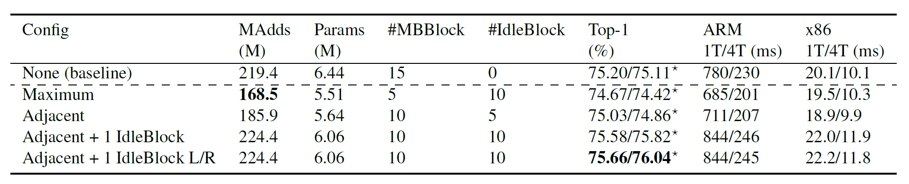
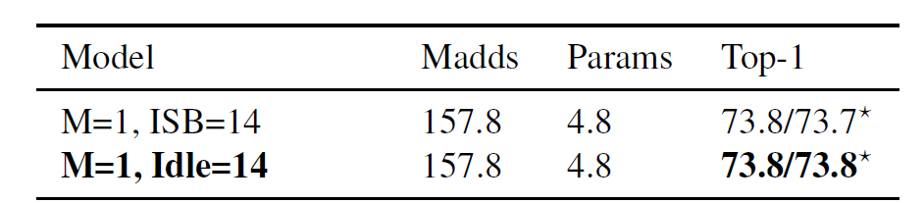
4
结论
RESEARCH BACKGROUND
Hybrid Composition
Applying different Hybrid Composition configurations on MobileNet-v3.
Impact of Channel Shuffle Operator:

Slide 17
RESEARCH BACKGROUND
谢谢！
TNANKS FOR LISTENING
Notes:
我的报告到此结束，谢谢各位老师。

